Slide 1
LCD & Actuation
Week 3 MTRX

Slide 2
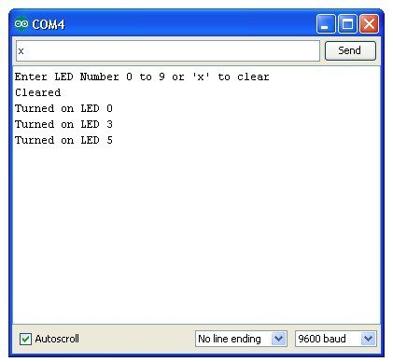
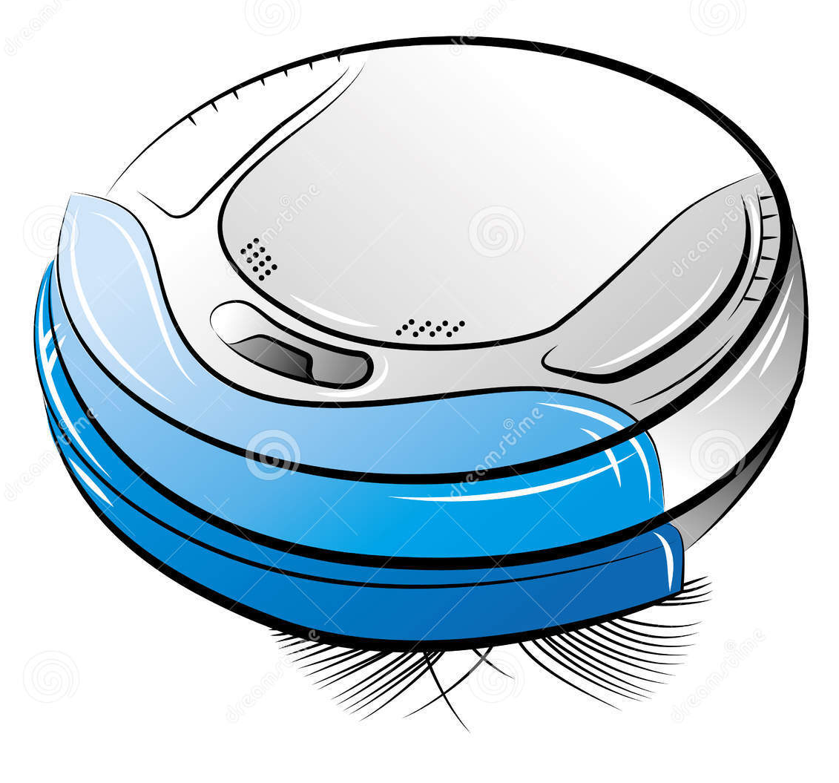
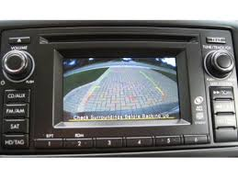

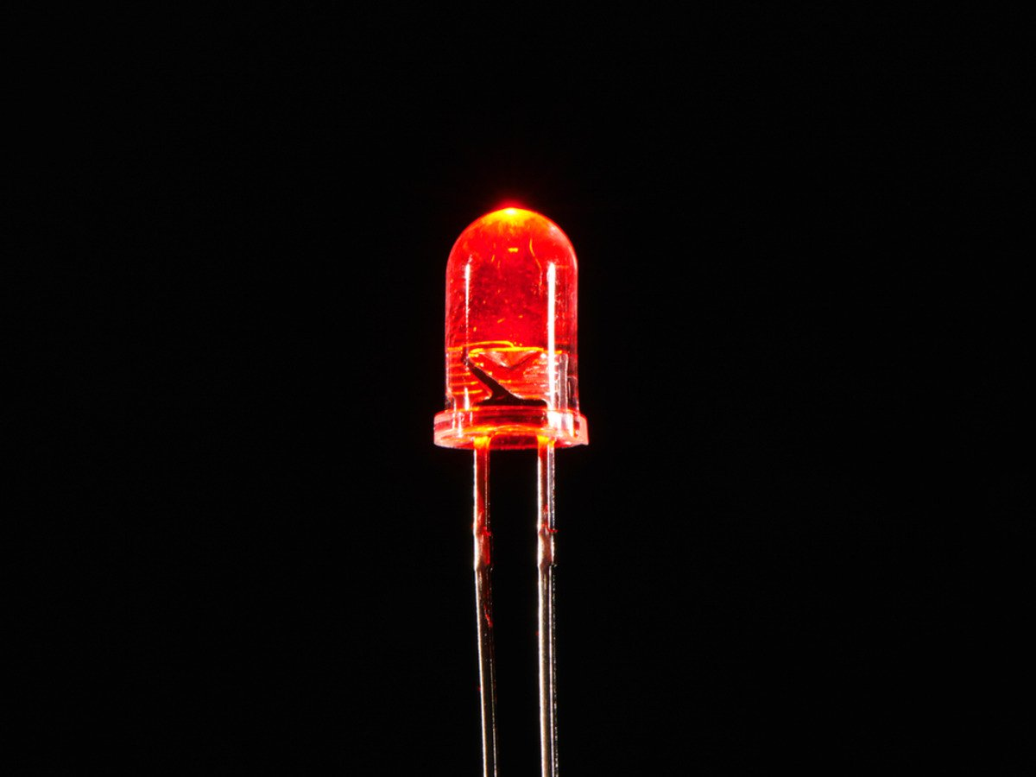
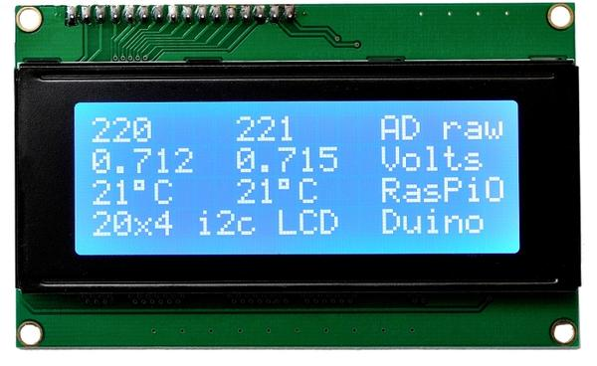
User Interface

Slide 3
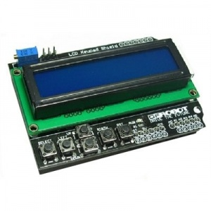
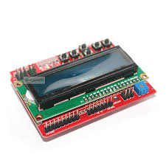
LCD

Slide 4
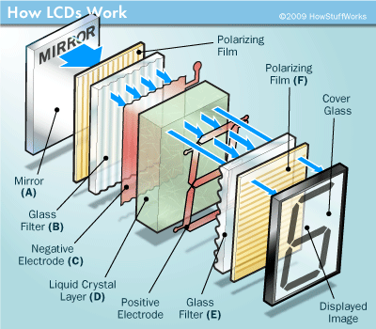
LCD

Slide 5
LCD-Overview
You will be using the LCD(TC1602) KeyPad Shield V1.0(Black) and V1.1(Red) by DFROBOT
The LCD is sized at 16x2. Which means you can fit a maximum of 2 lines of 16 characters. Supports 1602 white character blue backlight LCD.
Primarily 4 bit mode, 8 bit mode is possible.

Slide 6
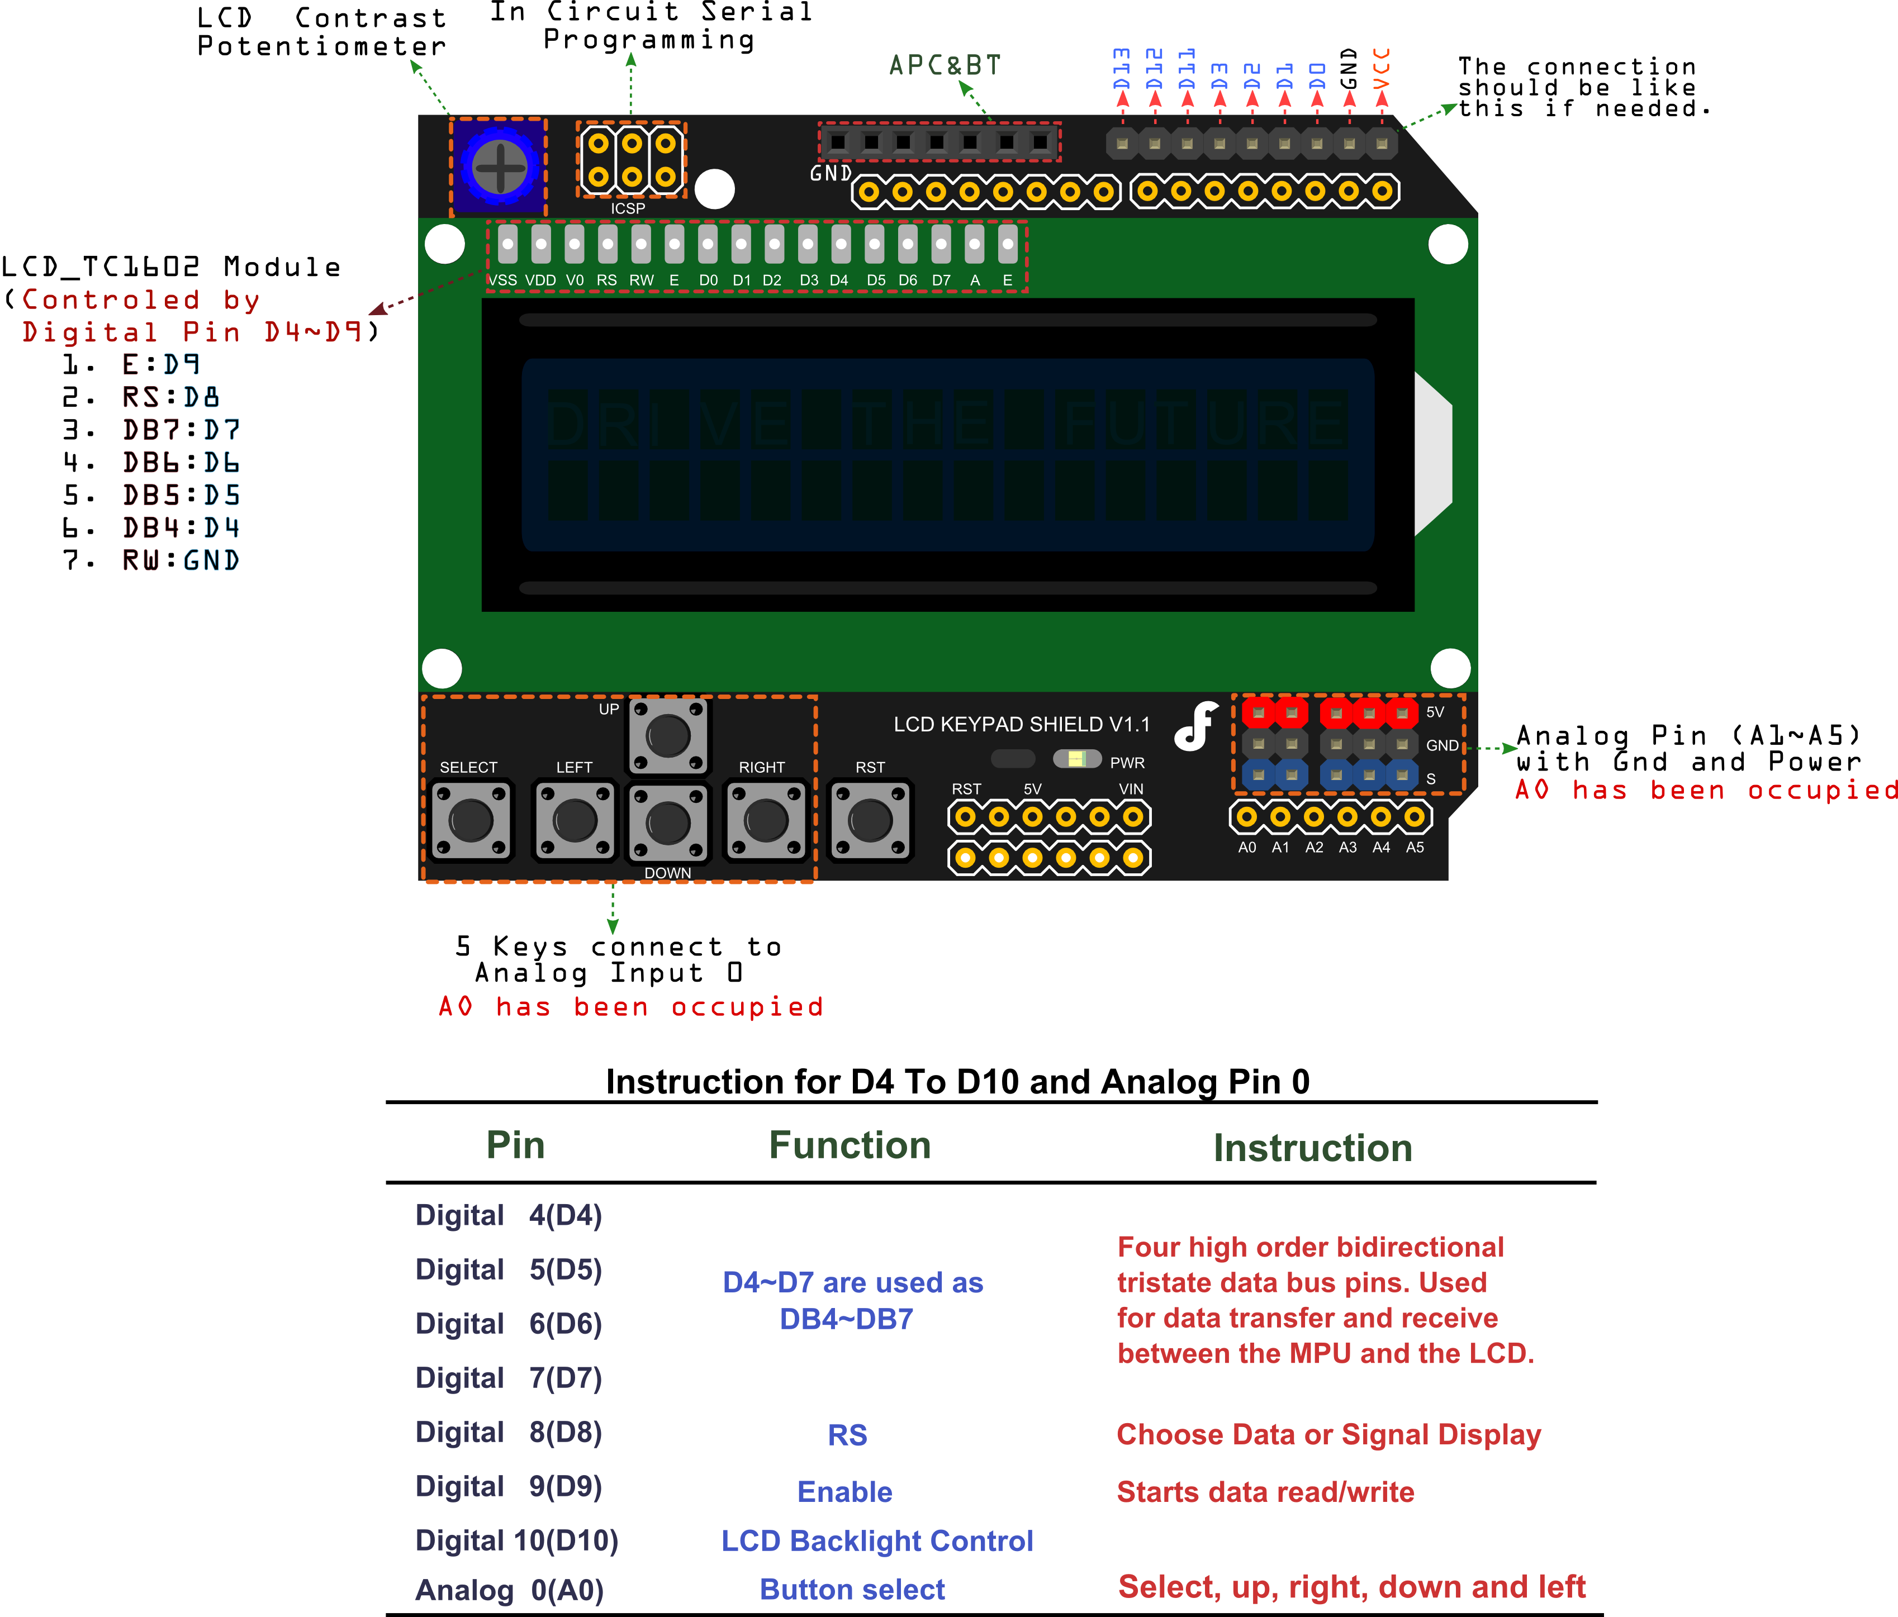
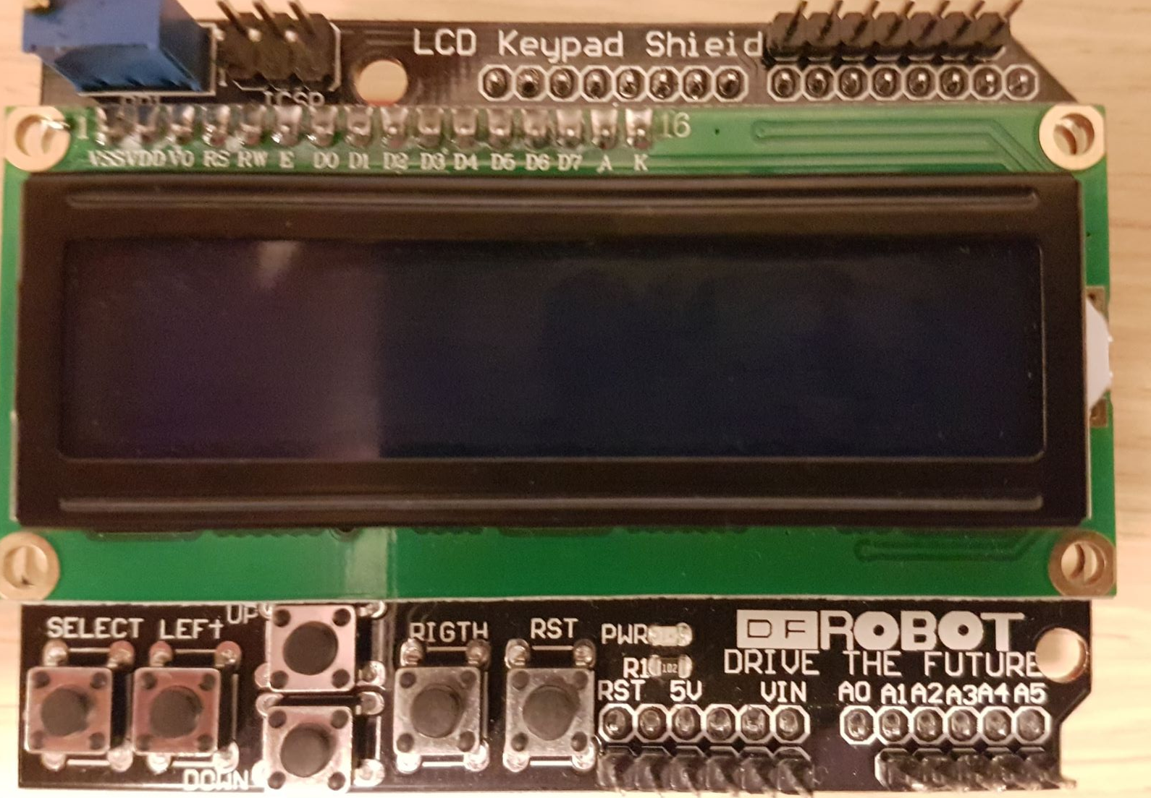
LCD-Hardware

Slide 7
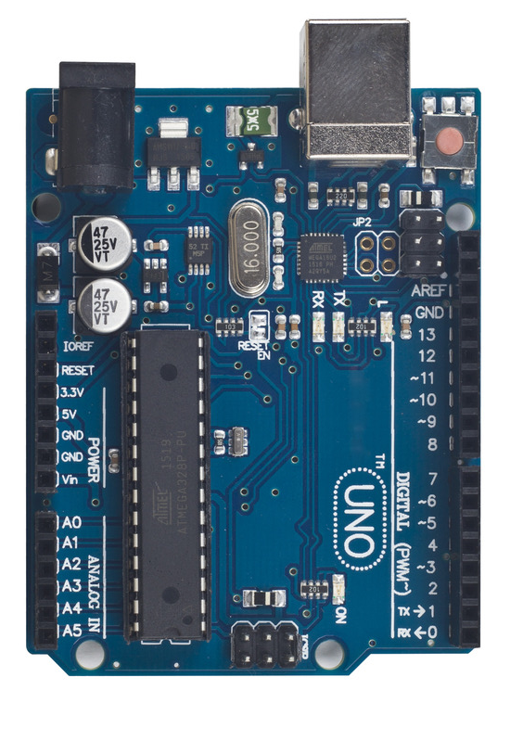
LCD-Pin allocation
UNO Pin | Function
5v | Vcc
GND | Ground
Analog 0 | Button (select, up, right, down and left)
Digital 4 | DB4
Digital 5 | DB5
Digital 6 | DB6
Digital 7 | DB7
Digital 8 | RS (Data or Signal Display Selection)
Digital 9 | Enable/Turn on
Digital 10 | Backlit Control

Slide 8
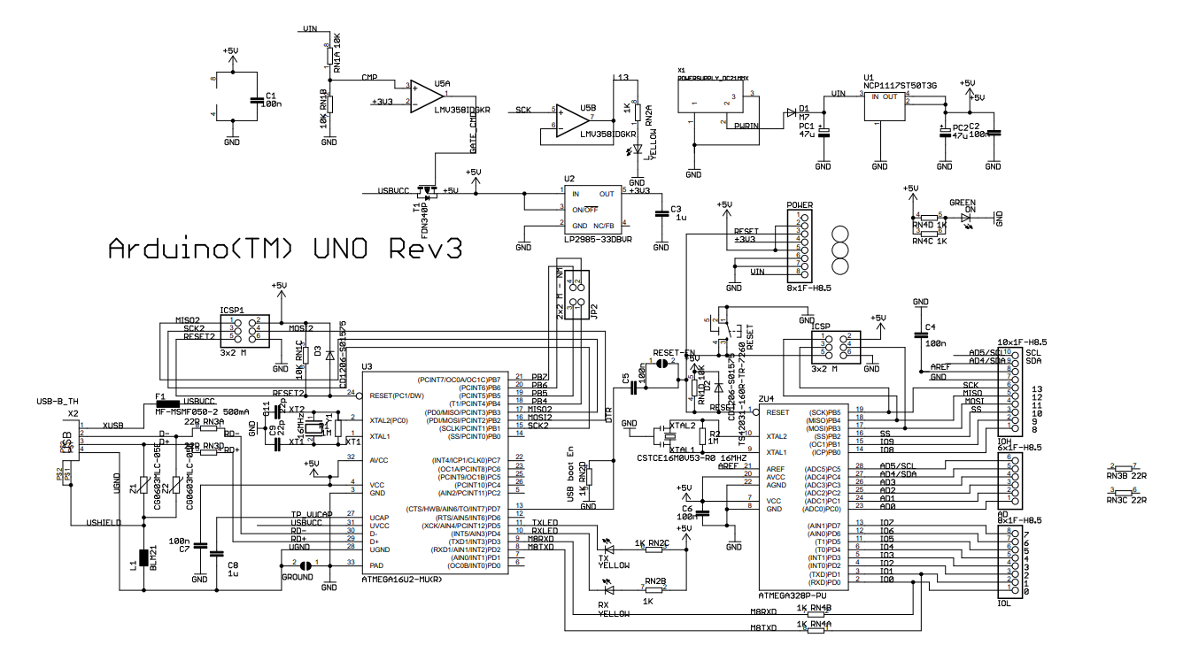
Find the pins used here

Slide 9
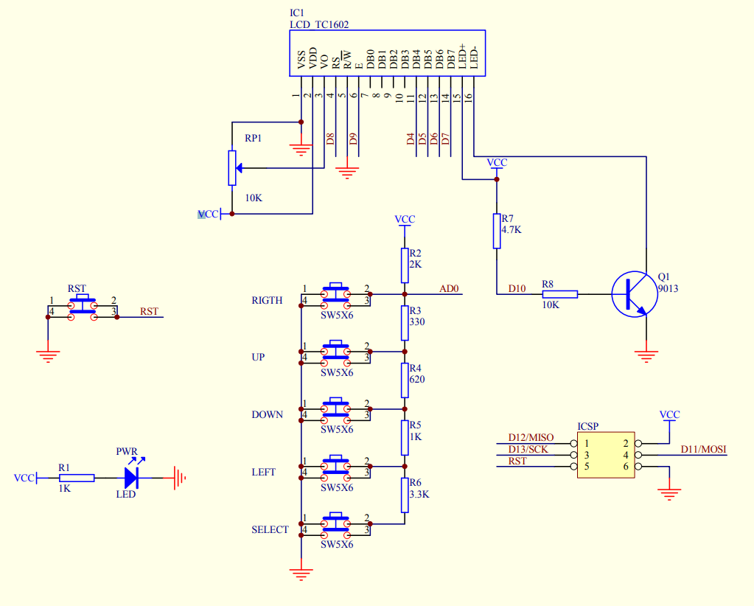
LCD-Schematic

Slide 10
Arduino LCD Library
You will be permitted to used the <LiquidCrystal.h> library
Useful functions
Function | Description
LiquidCrystal() | Creates a variable type used to call other functions. Used to enable data pins for LCD
begin() | Initializes LCD interface and allows you to set the dimensions (max 16,2)
clear() | Clears all characters on LCD
home() | clears and repositions LCD cursor to 0,0
setCursor() | Position LCD cursor. This sets where to start printing/writing characters
write() & print() | Outputs data type to LCD

Slide 11
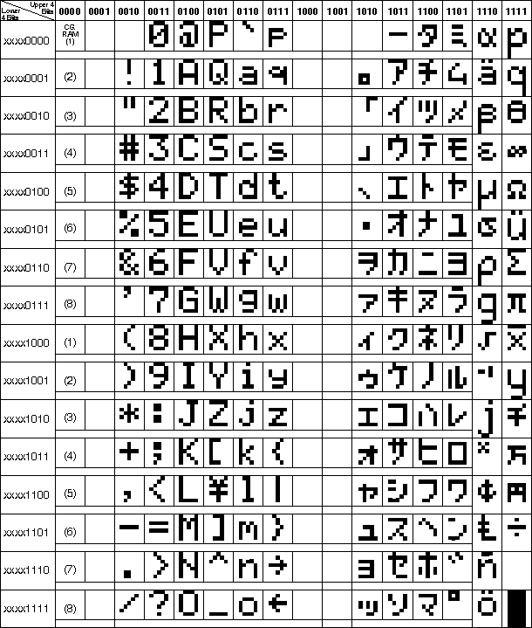
ASCII Table

Slide 12
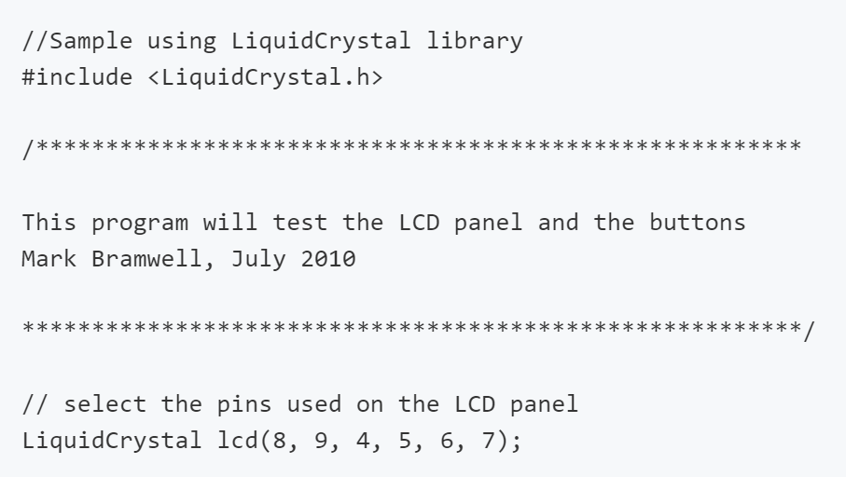
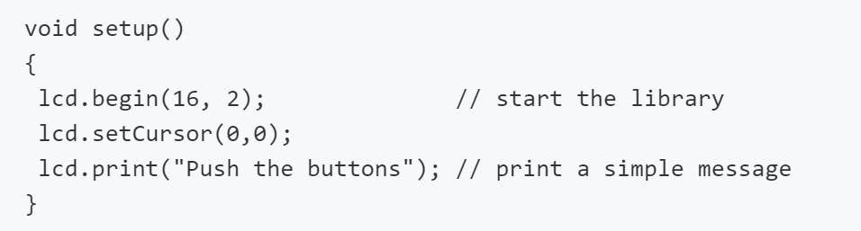
LCD Example

Slide 13
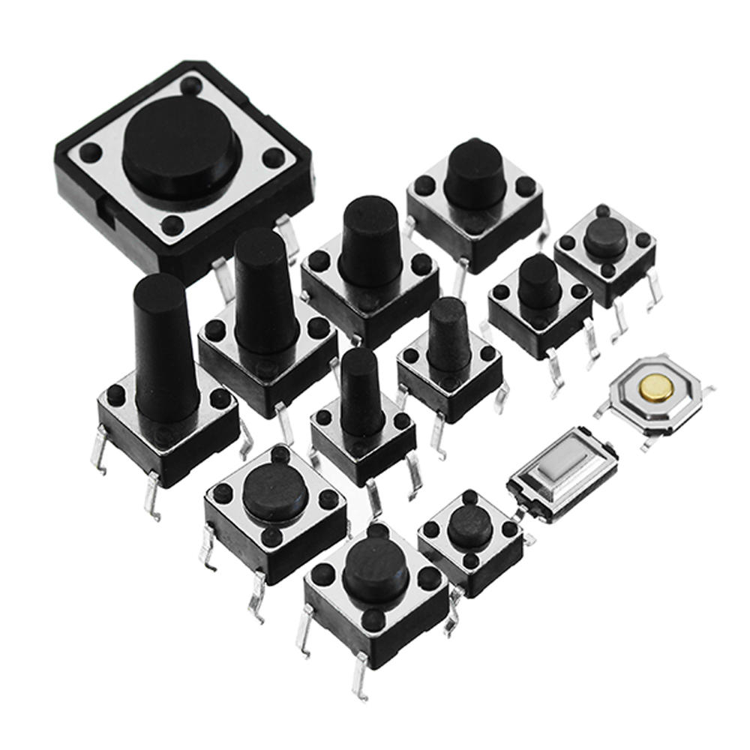
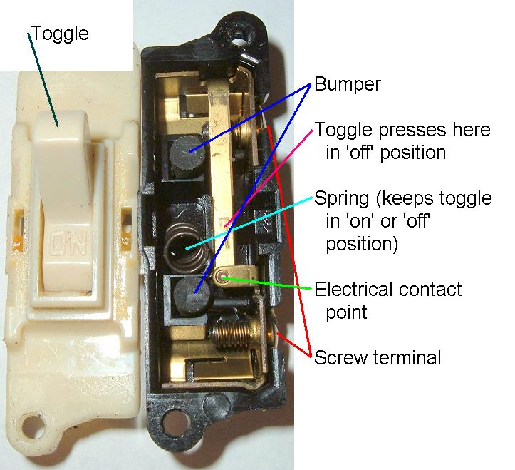
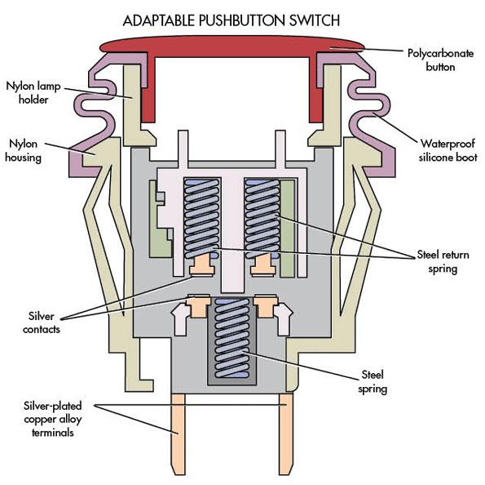
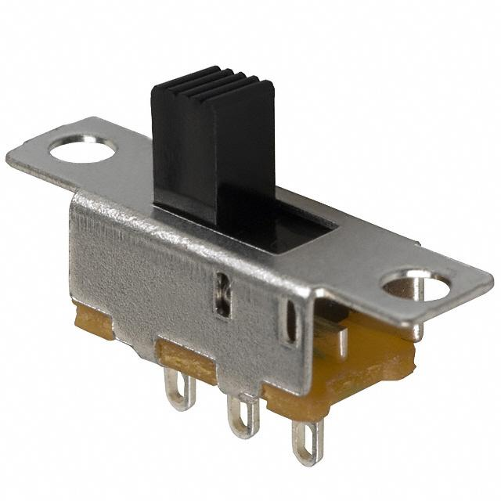
User Input- Buttons and Switches

Slide 14
Button-Schematic

Slide 15
LCD-Pin allocation
UNO Pin | Function
5v | Vcc
GND | Ground
Analog 0 | Button (select, up, right, down and left)

Slide 16
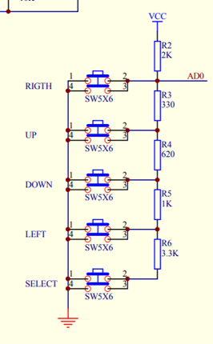
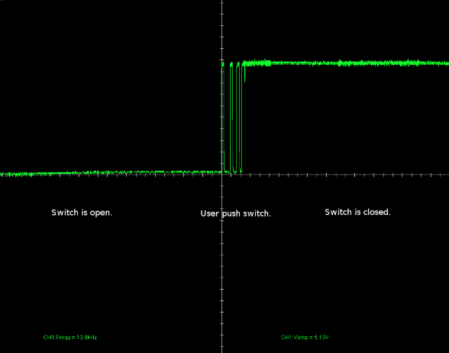
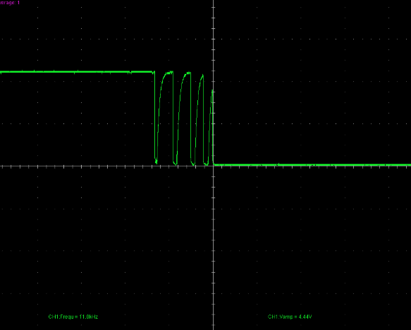
Bouncing
Push buttons are essentially a tactile mechanical switch that close the circuit when down.
Like most tactile switches, the circuits close when the two mechanical plate press into each other.
These plates often bounce against each other during the on and off periods causing signal spikes.
https://www.allaboutcircuits.com/technical-articles/switch-bounce-how-to-deal-with-it/

Slide 17
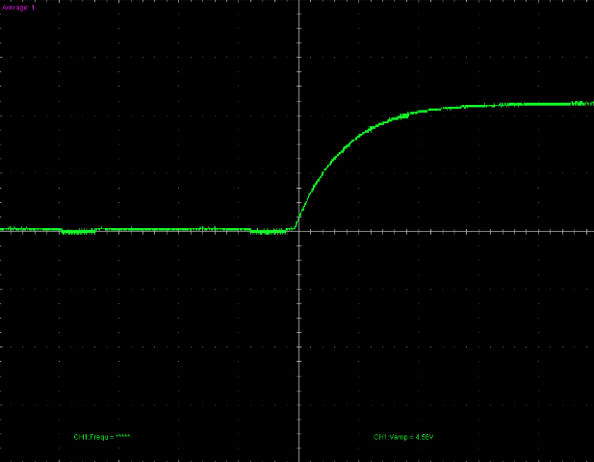
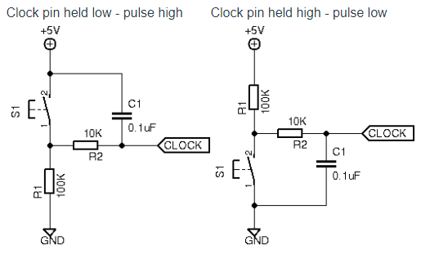
Debouncing
The two key ways to debounce a button is to:
Hardware: Use an Resistance-Capacitance (R-C) circuit
Software: Introduce a delay ~50ms after the first bounce i.e. when the button is first pressed.

Slide 18
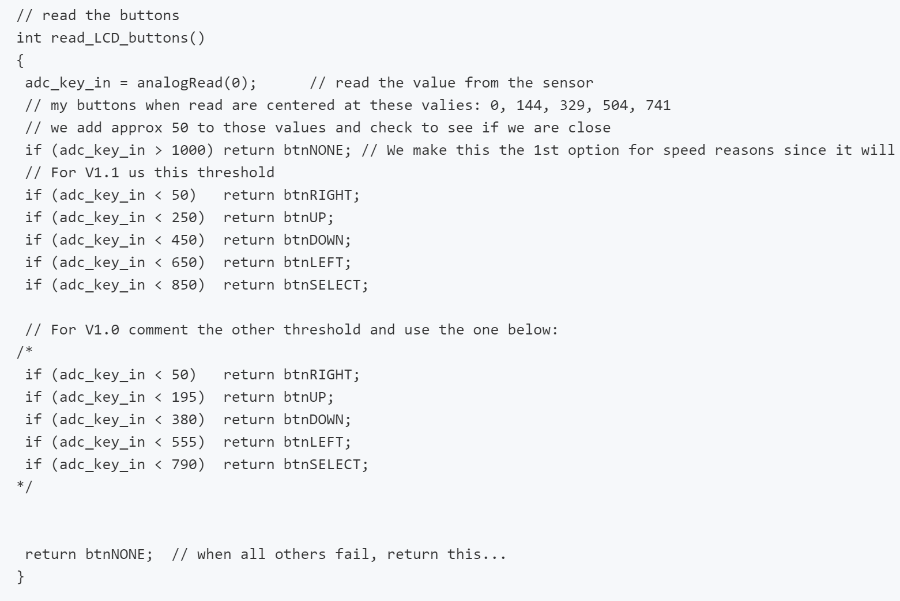
Example code Buttons
https://www.dfrobot.com/wiki/index.php/Arduino_LCD_KeyPad_Shield_(SKU:_DFR0009)

Slide 19
Things to look up
Shield manual, useful information plus sample codes
https://www.dfrobot.com/wiki/index.php/Arduino_LCD_KeyPad_Shield_(SKU:_DFR0009)
Arduino Standard library header file
https://github.com/jenschr/Arduino libraries/blob/master/LiquidCrystal/LiquidCrystal.h
https://www.arduino.cc/en/Reference/LiquidCrystal

Slide 20
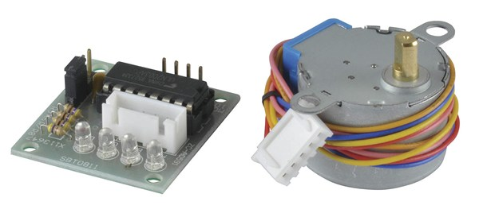
Stepper Motor

Slide 21
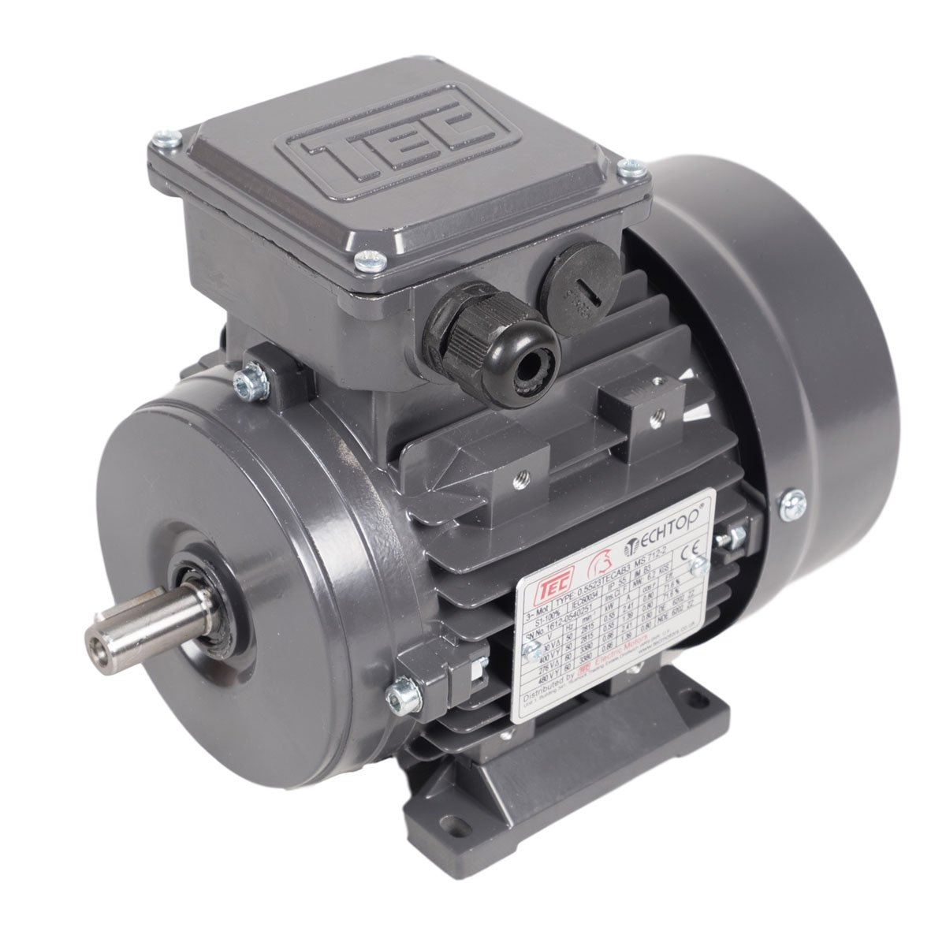
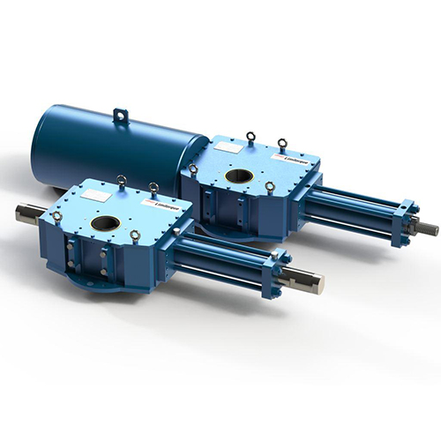
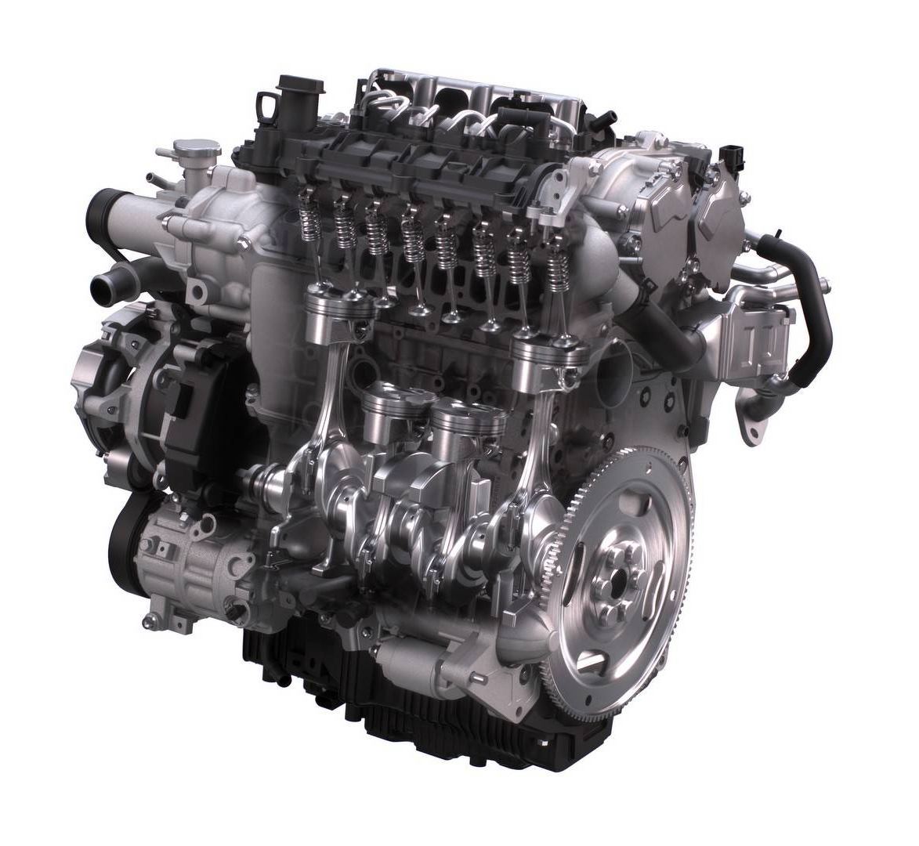
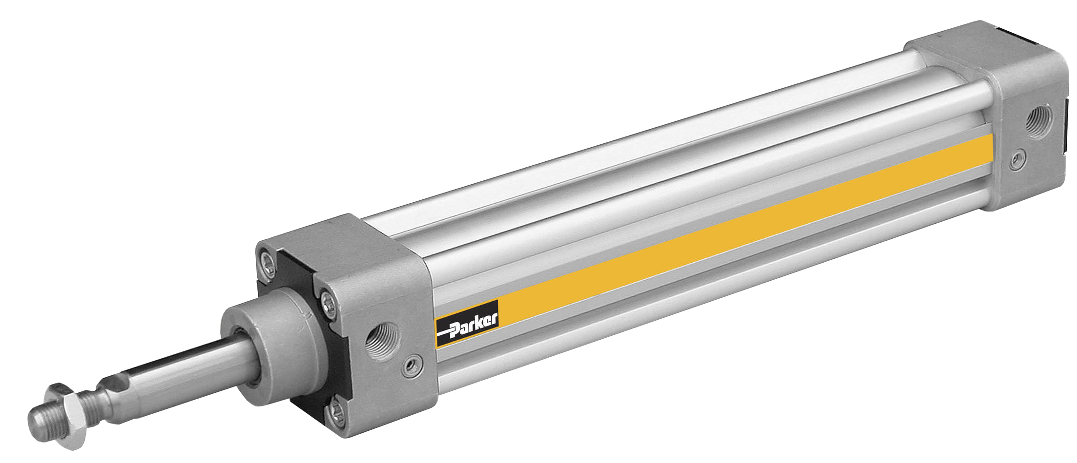
Actuators-Overview
Actuators are a component/device used to move or control something.
There are many types of actuators
Electric Motors
Hydraulic Drivers
Internal Combustion engines
Pneumatic Drives

Slide 22
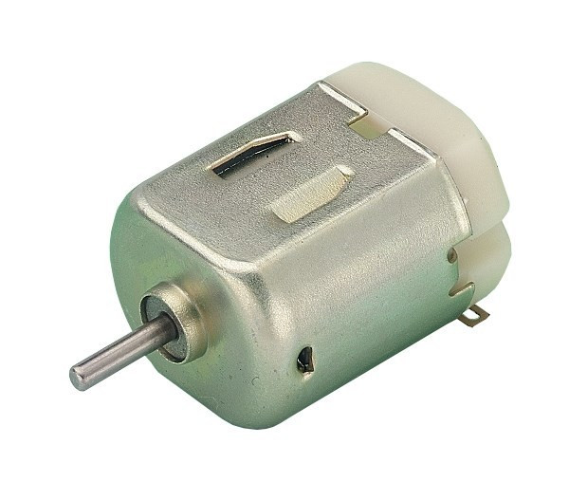
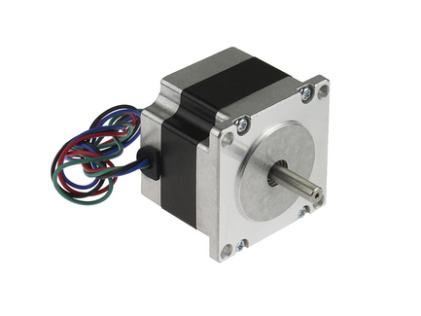
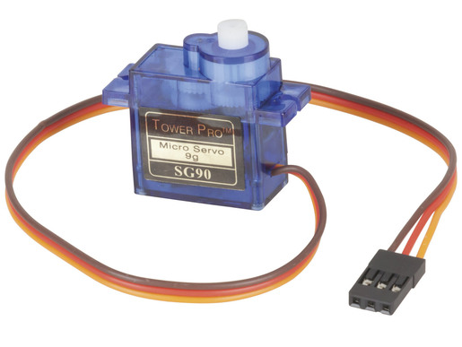
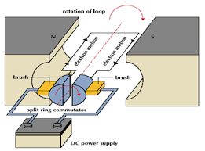
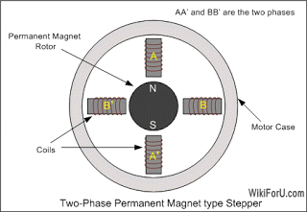
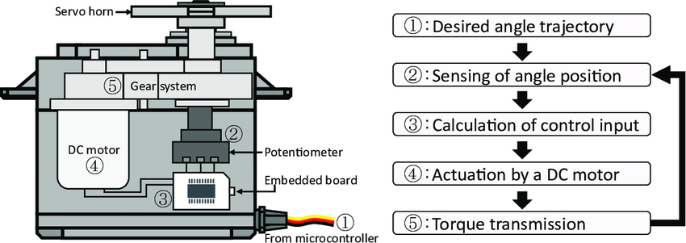
Types of motors you might use in mx2
DC motors
Stepper motors
Servo motors

Slide 23
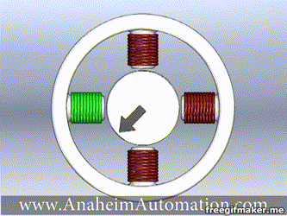
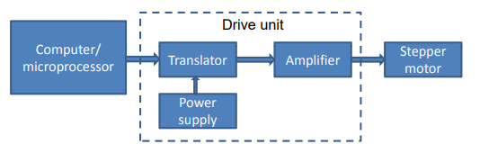
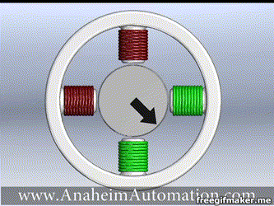
Electric Motor- Stepper Motors
Main advantage is Stepper motors allow for precise control of actuation without relying on a feedback mechanism.
It is a brushless DC electric motor that moves in step increments of a certain angle (Depending on Type and model).
Needs to be driven by a microprocessor and/or motor driver circuit.
Half Stepping
Full Stepping

Slide 24

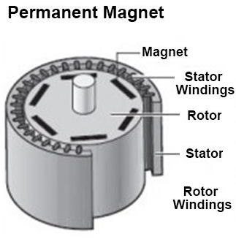
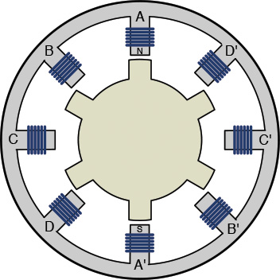
Stepper Motors-Types
Permanent Magnet (PM) Stepper motors
Rotor is made of permanent magnet.
Advantages
Low Cost
Can be made small
High Efficiency
Disadvantages
Low Torque
Less Acceleration
Low Step resolution
Variable Reluctance (VR) Stepper motors
Soft iron multi-toothed rotor and a wound stator
Advantages
Simplicity
Good Step Resolution(micro stepping)
More Robust and reliable
Disadvantages
Lower Torque

Slide 25

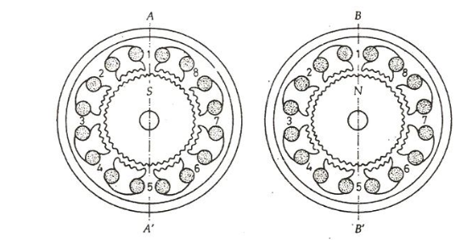
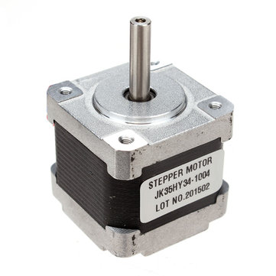
Stepper Motors-Types
Hybrid Stepper Motors
A permanent magnet rotor (PM) with the wound stator(VR)
Advantages
High Torque
Precise Steps
High Efficiency
Disadvantages
Higher Weight
Higher Cost

Slide 26
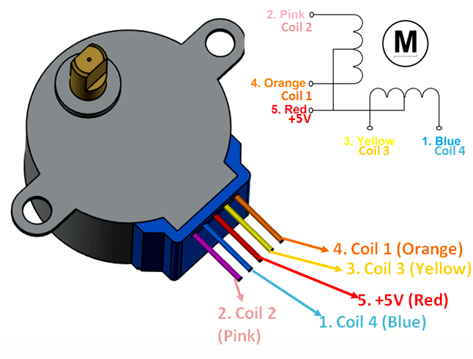
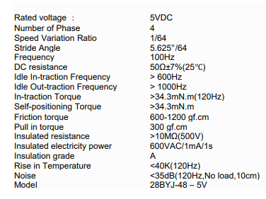
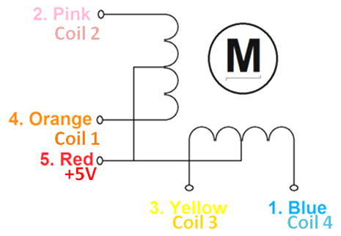
Our Stepper Motor
Unipolar Stepper Motor 28-BYJ48 driven by the ULN2003A chip
28-BYJ48 Specs

Slide 27
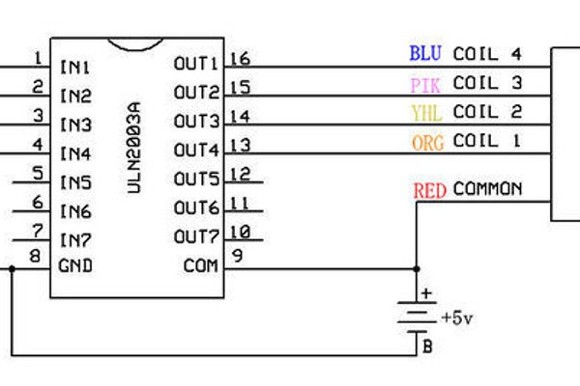
28-BYJ48+ULN2003A –Pin allocations
Four Digital Pins
5-12V Power Supply and Ground

Slide 28
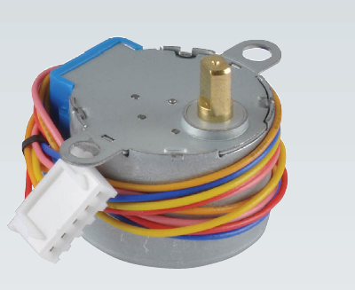
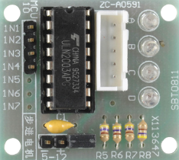
28-BYJ48+ULN2003A –Pin allocations
Four Digital Pins
5-12V Power Supply and Ground

Slide 29


Stepping
There is an Arduino standard library for stepper motors.
We will not be using that library.
ATMega328P can generate a control signal using the timer and toggling the digital pins connected to the driver chip.
Step Sequence Values
Step Numbers
Dashes (-) are 1s while blanks are 0

Slide 30
Step Calculations
Steps per Revolution Equation
Steps Per Rev=One Revolution Angle/Stride Angle
Stride Angle= Step Angle* Gear Ratio
*Refer to the 28BYJ-48 datasheet for stride angle*

Slide 31
TinkerCAD
Button
https://www.tinkercad.com/things/eHjl4HBjxZH-uts-mx2-lesson-plan-week-3-buttons
Stepper
https://www.tinkercad.com/things/daojVrvWkUU-uts-mx2-lesson-plan-week-3-stepper-motor

Slide 32
Exercise 1 SID display
Copy and Modify the sample code from https://www.dfrobot.com/wiki/index.php/Arduino_LCD_KeyPad_Shield_(SKU:_DFR0009)
Upload the sample code and study the code then modify the code to:
Print your SID onto the top line of the LCD
If you press the select key you will be able to edit your SID
If you press the UP button you SID will increase by 1 and if you press the DOWN button you SID will decrease by 1.
Remember Black LCD is v1.0 and Red LCD is v1.1

Slide 33
Exercise 2 Motor Control
Create a program that drives the stepper motor for one revolution clockwise then one revolution anti-clockwise and then repeats.
The motor should step at a frequency of around 1000Hz(1ms).
Do not use the Stepper.h Arduino Library. For driving the steps you must use the timer code you wrote last week.

Slide 34
Exercise 2 Steps
Calculate the amount of steps it will take to complete one revolution(see slide 20), will be the value for the stepsleft variable.
Then configure timer 2 to a prescaler that will trigger a 1ms counter register overflow.
Finally set up the switch case function for the stepper() function with the correct ports being toggled.

Slide 35

Exercise Bonus
Create something fun on the LCD.
E.g. A game

Slide 36




Setting up a basic timer cheat sheet
Should default to zero
At a prescaler value it should always be roughly
If you’re prescaler is set correctly then at 255 it should equal 1ms

Slide 37

See you guys next week

Slide 38
References
https://www.dfrobot.com/wiki/index.php/Arduino_LCD_KeyPad_Shield_(SKU:_DFR0009)
http://www.shieldlist.org/dfrobot/lcd
https://www.techbrands.com/store/productimages.aspx?n=XC4458&width=600&height=500&imageId=
Sarath’s Actuation Lecture
https://www.youtube.com/watch?v=dmk6zIkj7WM
https://cdn.shopify.com/s/files/1/1418/0136/products/B3_8a8d3a60-1380-4764-8a2c-d95e95889162.jpg?v=1507124979
https://www.flowserve.com/sites/default/files/2016-08/Flowserve-Limitorque-HydraulicActuators-LHS%26LHH.jpg
http://www.hydraulicspneumatics.com/sites/hydraulicspneumatics.com/files/Parker-Pneumatic-Cylinder.jpg
https://s1.cdn.autoevolution.com/images/news/skyactiv-3-engine-to-give-internal-combustion-longer-lease-of-life-123055_1.jpg
http://empoweringpumps.com/wp-content/uploads/sites/3/2017/01/ac-motor-vs-pm-motor-640x400-640x400.jpg
https://electrical-engineering-portal.com/few-words-about-stepper-motor-advantages-disadvantages-and-classification

Slide 39
References
http://www.informit.com/articles/article.aspx?p=2464009&seqNum=2
https://circuitglobe.com/hybrid-stepper-motor.html
https://img.staticbg.com/thumb/view/oaupload/banggood/images/D2/41/b03857e0-b6b7-45cf-a9ed-2c24469329dc.jpg
https://components101.com/motors/28byj-48-stepper-motor
https://www.instructables.com/id/BYJ48-Stepper-Motor/

